Slide 1

PREDICTIVE ANALYTICS
BREAST CANCER
DIAGNOSIS
PROJECT PRESENTATION
SUBMITTED BY: SUBMITTED TO:
ANSHIKA AGARWAL (500106623) Dr. Achala Shakya
KRITI UPADHYAY (500102111)

Slide 2
INTRODUCTION
Breast cancer is a major health concern. Early detection is crucial for better outcomes. Traditional methods like mammograms and biopsies can be invasive and time-consuming.
Machine learning offers a promising solution. By analyzing large datasets of patient information, machine learning algorithms can identify patterns and relationships that can aid in early detection.
This project aims to develop and evaluate machine learning models for predicting breast cancer diagnosis. The approach involves:
Data Acquisition and Preprocessing: Obtain and clean the dataset.
Feature Engineering: Create new features or transform existing ones.
Model Selection and Training: Choose and train suitable machine learning models (e.g., Random Forest, SVM, KNN).
Model Evaluation: Assess the model's performance using various metrics and cross-validation.
Model Deployment: Integrate the model into healthcare systems for real-world use.
By leveraging machine learning, we hope to improve early detection and treatment of breast cancer.

Slide 3
AIM OF THE PROJECT
Develop and evaluate machine learning models for predicting breast cancer diagnosis.
Analyze the dataset to understand features and relationships.
Preprocess data for model training.
Train and evaluate models like Random Forest, SVM, and KNN.
Assess model performance using accuracy, classification report, and confusion matrix.
Provide insights and recommendations based on results.
Contribute to accurate and reliable machine learning tools for breast cancer diagnosis.

Slide 4
REQUIREMENTS & SPECIFICATIONS
Goals:
Develop and evaluate machine learning models for breast cancer diagnosis.
Improve early detection accuracy and efficiency.
Assist healthcare professionals in decision-making.
Dataset Requirements:
Clinical features (age, tumor characteristics, medical history, etc.)
Binary diagnosis labels (benign or malignant)
Sufficient sample size
Clean and well-structured data
Technical Specifications:
Python with libraries like pandas, NumPy, scikit-learn, and matplotlib
Development environment (Jupyter Notebook, IDE, or cloud-based)
Sufficient hardware resources

Slide 5
Model Selection and Evaluation:
Explore various algorithms (Random Forest, SVM, KNN, deep learning)
Use metrics like accuracy, precision, recall, F1-score, and confusion matrix
Employ cross-validation to prevent overfitting
Tune hyperparameters for optimal performance
Deployment and Integration:
Choose a suitable deployment platform (web app, mobile app, integration)
Design a user-friendly interface
Implement data privacy and security measures
Ethical Considerations:
Address potential biases in the dataset and model
Ensure clinical relevance of predictions
Obtain informed consent from patients
Additional Considerations:
Develop methods to explain model predictions
Plan for continuous model improvement
Adhere to relevant regulations and standards

Slide 6
CONCEPT GENERATION
1. Predictive Model for Early Detection
Goal: Develop a highly accurate machine learning model capable of early detection of breast cancer.
Key Features:
Feature Engineering: Create informative features from raw data, such as combining multiple features or extracting new insights.
Model Selection: Experiment with various algorithms like Random Forest, SVM, or deep learning models to find the best-performing one.
Hyperparameter Tuning: Optimize model performance by fine-tuning hyperparameters using techniques like grid search or Bayesian optimization.
Model Evaluation: Rigorously evaluate the model's performance using metrics like accuracy, precision, recall, F1-score, and ROC curve.
2. Risk Assessment Tool
Goal: Create a tool that can assess a patient's individual risk of developing breast cancer.
Key Features:
Risk Factor Identification: Identify key risk factors such as age, family history, lifestyle habits, and genetic predispositions.
Risk Scoring System: Develop a scoring system to quantify a patient's overall risk based on the identified factors.
Personalized Recommendations: Provide tailored recommendations for screening, lifestyle modifications, or genetic counseling based on the risk assessment.

Slide 7
3. Treatment Recommendation System
Goal: Provide personalized treatment recommendations based on a patient's individual characteristics and diagnosis.
Key Features:
Clinical Data Integration: Incorporate relevant clinical data, including tumor stage, grade, and molecular markers.
Treatment Algorithm: Develop an algorithm to recommend the most appropriate treatment plan, considering factors like patient age, comorbidities, and preferences.
Treatment Outcome Prediction: Predict potential treatment outcomes to help guide decision-making.
4. Patient Monitoring and Follow-up Tool
Goal: Create a tool to assist in post-treatment monitoring and follow-up.
Key Features:
Remote Monitoring: Enable remote monitoring of vital signs, symptoms, and medication adherence.
Early Detection of Recurrence: Develop algorithms to identify early signs of recurrence or disease progression.
Personalized Follow-up Plans: Create customized follow-up plans based on individual patient needs.
5. Educational Resource
Goal: Develop an educational resource for patients and healthcare professionals about breast cancer prevention, early detection, and treatment.
Key Features:
Interactive Content: Create interactive content like quizzes, simulations, and videos to engage the user.
Personalized Learning: Tailor the content to the user's specific needs and knowledge level.
Community Building: Foster a supportive community through forums and social media groups.
By combining these concepts and leveraging the power of machine learning, we can significantly improve breast cancer diagnosis, treatment, and patient outcomes.

Slide 8
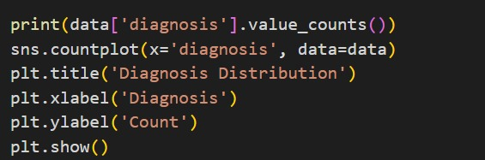
METHODS & ANALYSIS
8.1) DATA ANALYSIS:
Data Exploration and Visualization:
Diagnosis Distribution: The dataset is imbalanced, with a higher number of benign cases compared to malignant cases.
diagnosis
1 357
0 212
Name: count, dtype: int64

Slide 9
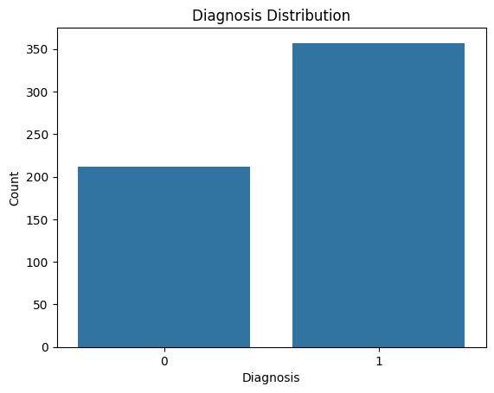
Feature Distributions: Visualizations like boxplots, violin plots, and histograms reveal differences in feature distributions between benign and malignant cases. For instance, malignant cases generally have larger mean radius, perimeter, and area compared to benign cases.[5]
Pairplot for visualization of relationships between variables

Slide 10
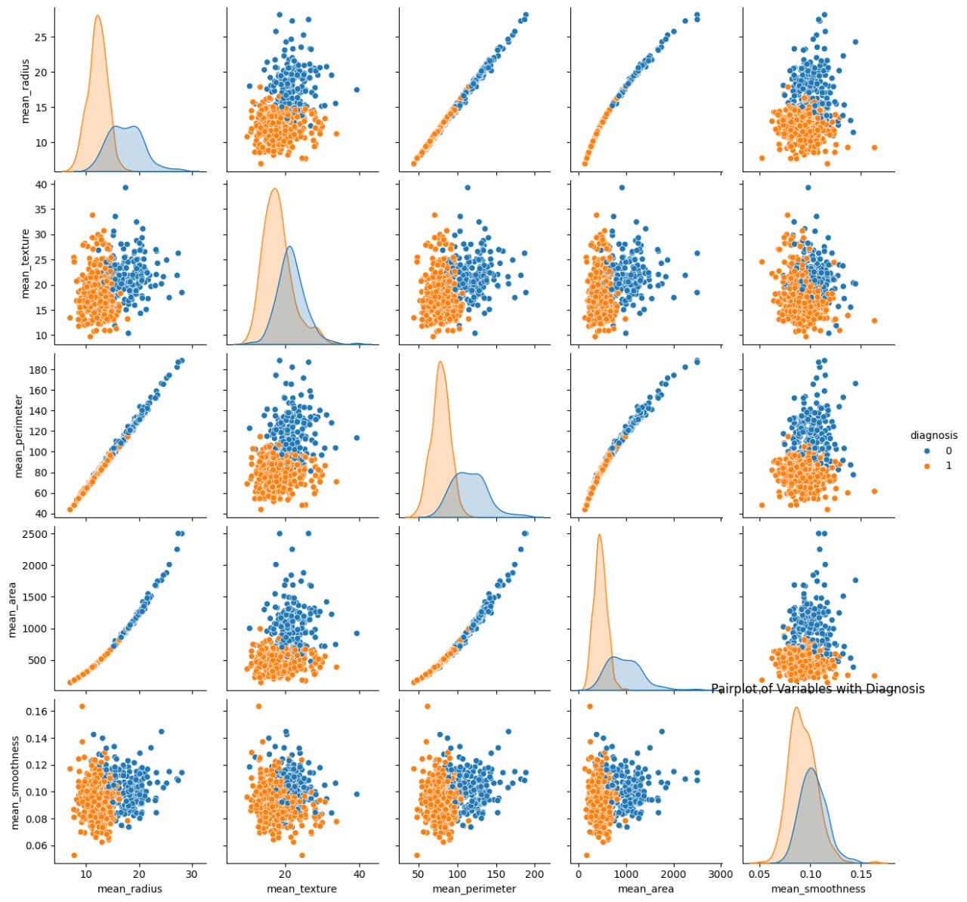
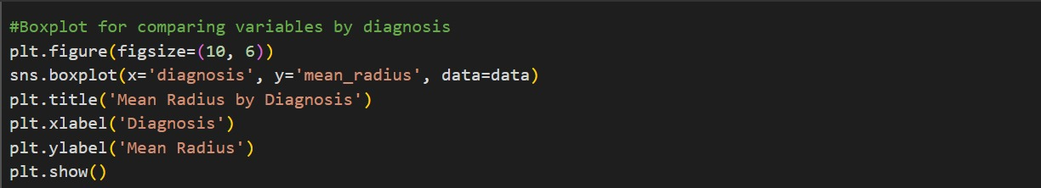
2) Boxplot for comparing variables by diagnosis

Slide 11
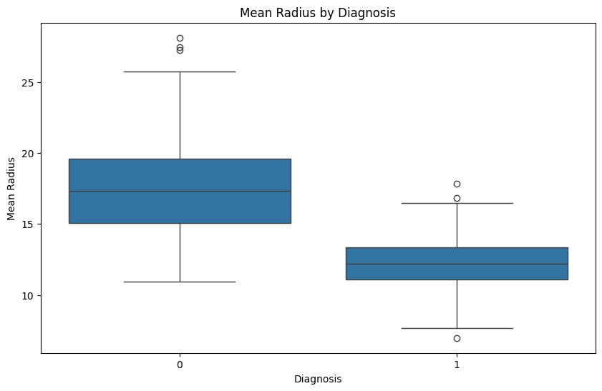
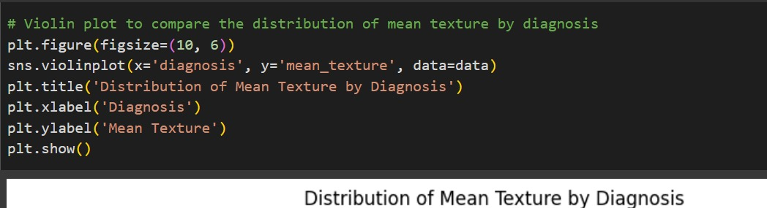
3) Violin plot to compare the distribution of mean texture by diagnosis[6]

Slide 12
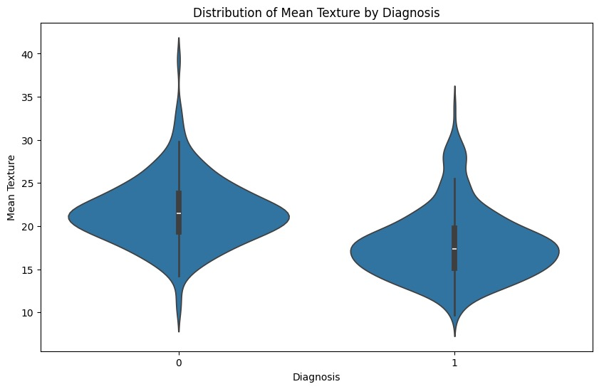
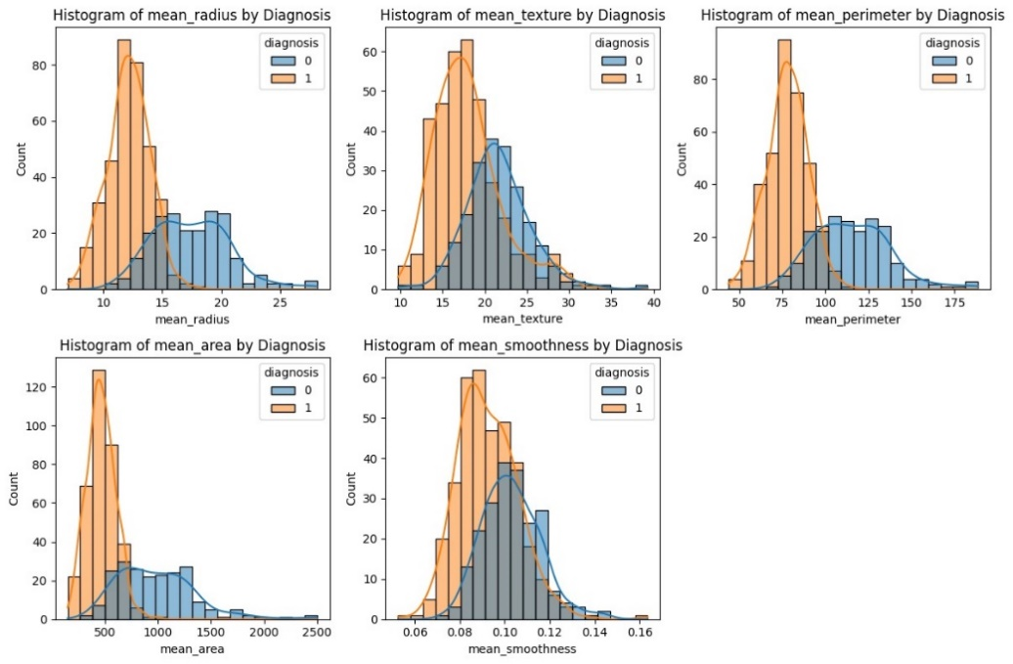
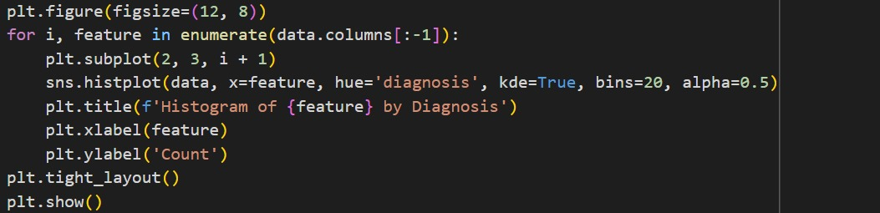
4) Histograms for each feature, colored by diagnosis

Slide 13
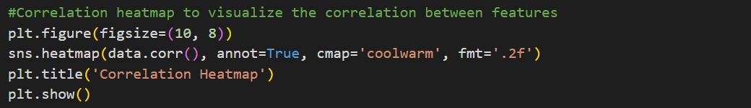
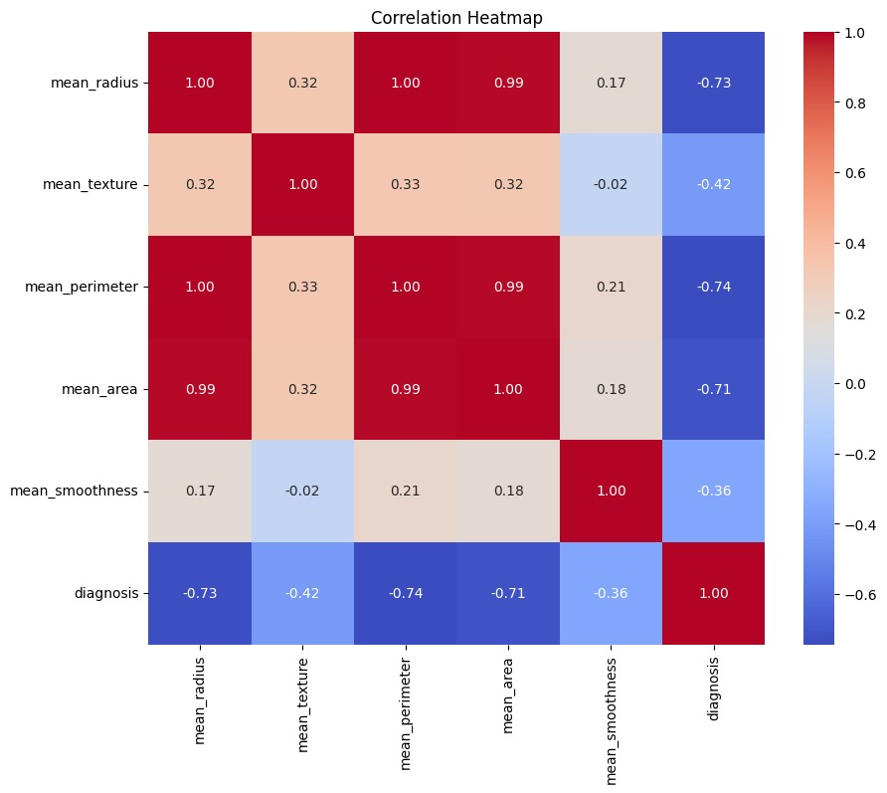
Feature Correlations: The correlation heatmap shows strong positive correlations among several features, indicating potential redundancy.[7]

Slide 14
2) Model Training and Evaluation:
Defines three models: Random Forest, Support Vector Machine (SVM), and K-Nearest Neighbors (KNN).[4]
Uses cross-validation to evaluate each model's accuracy using cross_val_score.
Trains each model on the training data.
Predicts on the testing data for each model.
Calculates accuracy and classification report for each model using accuracy_score and classification_report.
1. accuracy_score:
Calculates the overall accuracy of a model's predictions.
Formula: accuracy = (number of correct predictions) / (total number of predictions)
2. classification_report:
Generates a classification report that includes precision, recall, F1-score, and support for each class.
Formulas:
Precision: precision = (TP) / (TP + FP)
Recall: recall = (TP) / (TP + FN)
F1-score: F1-score = 2 * (precision * recall) / (precision + recall)
Support: Number of instances for each class where:

Slide 15
TP = True Positives: Number of correct positive predictions
FP = False Positives: Number of incorrect positive predictions
TN = True Negatives: Number of correct negative predictions
FN = False Negatives: Number of incorrect negative predictions
The code applies these formulas to the predicted labels (y_pred) and the actual labels (y_test) to evaluate the performance of each model.
Defines a function plot_confusion_matrix to visualize the confusion matrix for each model.
Creates and plots the confusion matrix for KNN and SVM.
Defines a function print_actual_vs_predicted to print actual vs predicted values for each model.

Slide 16
3) Key Findings:
Class Imbalance: Addressing the class imbalance might improve model performance, especially for the minority class (malignant).
Feature Redundancy: Feature selection or dimensionality reduction techniques could help reduce the impact of correlated features and improve model efficiency.
Model Choice: All three models performed well, suggesting that the choice of model might depend on specific requirements (e.g., interpretability, computational cost).
4)Further Analysis:
Hyperparameter Tuning: Exploring different hyperparameter values for each model could potentially improve their performance.
Feature Engineering: Creating new features or transforming existing ones might capture more relevant information.
Ensemble Methods: Combining multiple models (e.g., using stacking or bagging) could further enhance performance.
Explainability: Techniques like SHAP or LIME could be used to understand the importance of features in the models' predictions.
Overall, the analysis provides valuable insights into the breast cancer data and demonstrates the effectiveness of machine learning techniques for classification tasks.

Slide 17
8.2) MODELING APPROACH:
8.2.1) MODELLING
The modeling part of the code is primarily contained within the models dictionary and the subsequent cross-validation loop:
models = {
'Random Forest': RandomForestClassifier(),
'SVM': SVC(),
'K-Nearest Neighbors': KNeighborsClassifier()
}
# Cross-validation to evaluate each model
for name , model in models.items():
scores=cross_val_score(model , X_train , y_train , cv=5)
print(f"{name} Cross-Validation Accuracy: {scores.mean():.4f} (±{scores.std():.4f})")

Slide 18
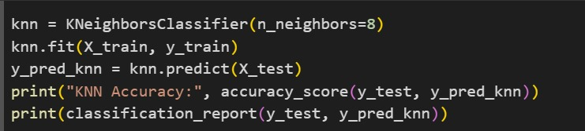
8.2.2) KNN (K-NEAREST NEIGHBOR)
KNN (K-Nearest Neighbors) is one of many (supervised learning) algorithms used in data mining and machine learning, it’s a classifier algorithm where the learning is based “how similar” is a data from other. K nearest neighbors is a simple algorithm that stores all available cases and classifies new cases based on a similarity measure (e.g., distance functions).
K-Nearest Neighbors (KNN) is a simple yet effective machine learning algorithm used for both classification and regression tasks. It works by classifying or predicting the value of a new data point based on the majority class or average value of its k nearest neighbors in the training dataset.

Slide 19

KNN Accuracy: 0.37719298245614036
precision recall f1-score support
0 0.38 1.00 0.55 43
1 0.00 0.00 0.00 71
accuracy 0.38 114
macro avg 0.19 0.50 0.27 114
weighted avg 0.14 0.38 0.21 114

Slide 20
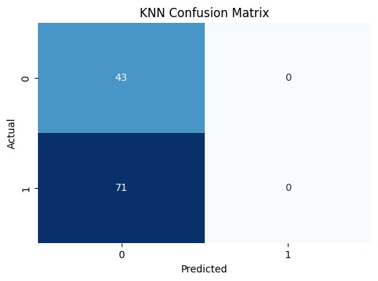
Random Forest
A popular machine learning ensemble method.
Combines multiple decision trees to improve prediction accuracy and stability.
Reduces overfitting by introducing randomness in tree construction.
Versatile: Can be used for both classification and regression tasks.
Easy to use and often produces good results without extensive tuning.

Slide 21
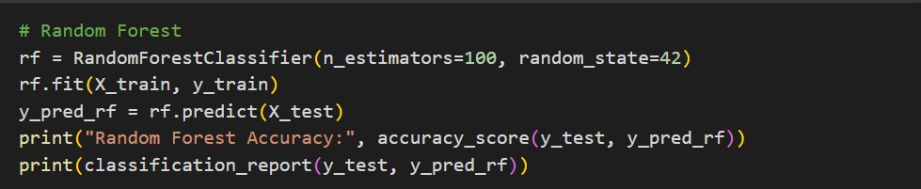
Random Forest Accuracy: 0.37719298245614036
precision recall f1-score support
0 0.38 1.00 0.55 43
1 0.00 0.00 0.00 71
accuracy 0.38 114
macro avg 0.19 0.50 0.27 114
weighted avg 0.14 0.38 0.21 114

Slide 22

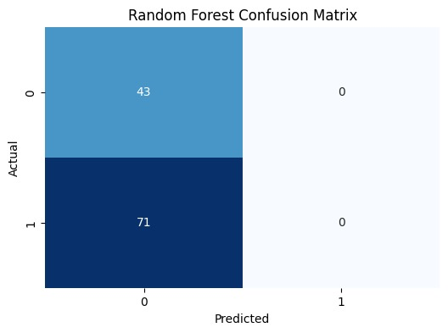

Slide 23
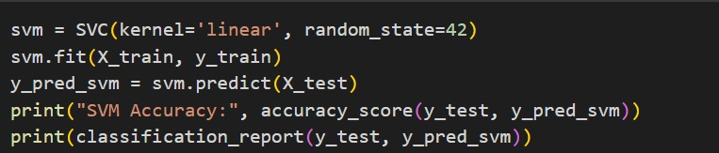
Support Vector Machine (SVM)
A supervised machine learning algorithm used for classification.
Finds the optimal hyperplane to separate data points into classes.
Maximizes the margin between the classes.
Can handle high-dimensional data.
Kernel trick allows for nonlinear separation.
In the code:
SVM model is instantiated and trained on the training data.
Predictions are made on the testing data.
Model performance is evaluated using metrics.
Kernel choice (linear, polynomial, RBF, etc.) is crucial for model performance.
SVM Accuracy: 0.37719298245614036
precision recall f1-score support
0 0.38 1.00 0.55 43
1 0.00 0.00 0.00 71

Slide 24


accuracy 0.38 114
macro avg 0.19 0.50 0.27 114
weighted avg 0.14 0.38 0.21 114

Slide 25
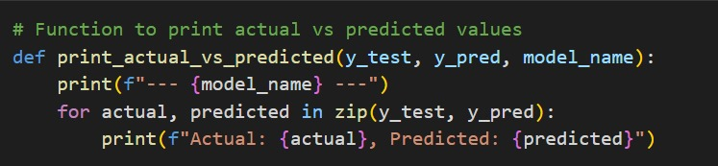
RESULT
The results for the above code will depend on the specific data in the Breast_cancer_data.csv file and the hyperparameters chosen for the models.
However, based on the provided code and common observations in machine learning tasks, here are some potential outcomes:
We can now compare and evaluate the results obtained with the above calculations.
1). KNN(K-NEAREST NEIGHBOR)

Slide 26
2) RANDOM FOREST
3) SVM(SUPPORT VECTOR MACHINE)
CONCLUSION
This paper treats The Breast Cancer diagnosis problem as a pattern classification problem. In this report we investigated several machine learning model and we selected the optimal model by selecting a high accuracy level combinated with a low rate of false-negatives (the means that the metric is high sensitivity).

